Slide 1

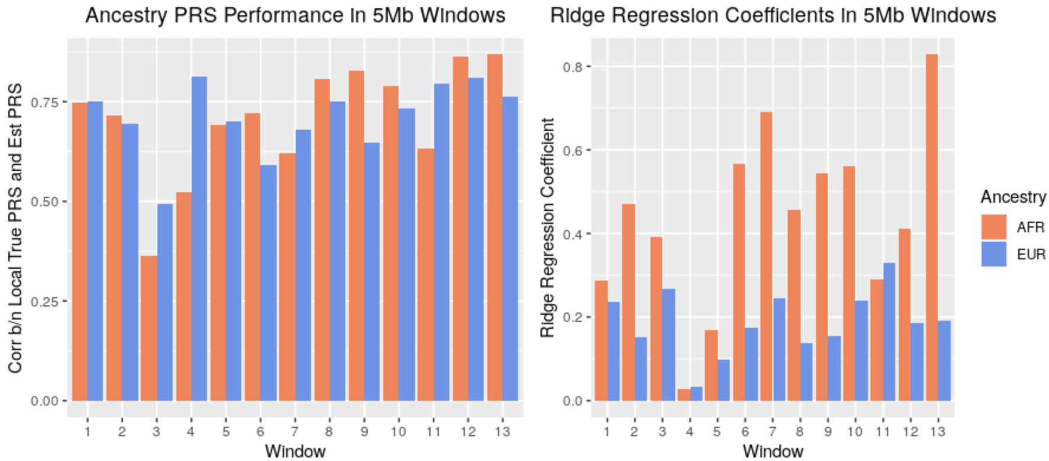
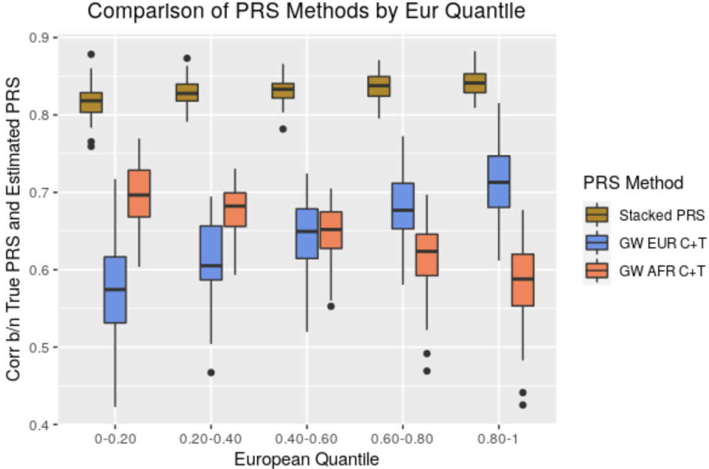
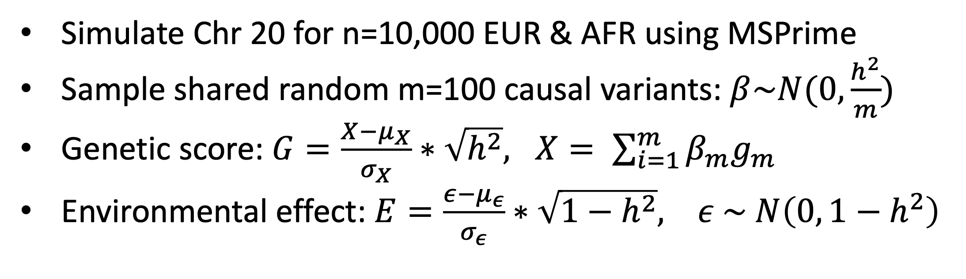
A Stacking Framework for Polygenic Risk Prediction in Admixed Individuals
ç
Kevin Liao¹, Sebastian Zöllner^{1,2}
¹Department of Biostatistics, University of Michigan; ²Department of Psychiatry, University of Michigan
Contact
ksliao@umich.edu
www.kliao12.github.io
Polygenic Risk Scores (PRS) Combine
GWAS Effect Sizes across Risk Variants
Local Window Ancestry Specific PRS
Stacking Local Window Ancestry-Specific PRS
However estimated effect sizes can vary across populations due to differences in:
Linkage disequilibrium and allele frequencies
Environment and demographic history
Most high-powered GWAS conducted in Europeans
Key Features of Framework:
1) Local Windows 2) Ancestry Specific PRS 3) Stacking
Admixed genomes across samples split into 5Mb windows
Problem: Performance of PRS using well estimated European GWAS effect sizes in another population degrade as genetic divergence increases
Background
PRS Methods for Admixed Samples
1) Window 1 EUR PRS
2) Window 1 AFR PRS
1) Window k EUR PRS
2) Window k AFR PRS
Admixed individuals have segments of genome tracing back to multiple populations
Performance of PRS for African Americans computed using single pop GWAS (EUR or AFR) shows strong ancestry dependence
Recent methods propose leveraging GWAS from multiple pops to accommodate admixture
Split genome into 5Mb windows and for each window compute EUR PRS and AFR PRS via C+T with P-value thres of 5e-4 using ancestry-specific GWAS from simulated pops
Local windows used to accommodate differential performance of ancestry-specific PRS based on local admixture driving unique LD patterns
Showing for Single Simulation:
Across 5Mb windows, performance of ancestry-specific PRS varies
Penalized regression over weights better performing ancestry-specific PRS
Methods
Results
Stacked PRS Outperforms Across n=75 Simulations
Problem: PRS Methods for admixed samples are scarce and there is no consensus best approach among recent methods
Stacking Framework
Stacked PRS outperforms PRS using single GWAS across all ancestry quantiles
Stacking removes performance’s strong ancestry dependence
Ridge Regression Model Stacking
Local Window Ancestry-specific PRS:
Develop method to create PRS in admixed samples with following properties:
$$Y=β_{1}W_{1, Eur_PRS}+β_{2}W_{1, Afr_PRS}+…+β_{k}W_{k,Eur_PRS}+β_{k+1}W_{k,Afr_PRS}$$
Goal
1) Considers unique local admixture in sample
2) Leverages population specific GWAS effect sizes
3) Performance independent of global ancestry
Training Data:
N = 5,000
Training AA
Compute Local Window Ancestry PRSs
Stack local PRS in Ridge Model to Learn Weights
1) Simulate EUR and AFR GWAS Effect Sizes
Simulate Chr 20 for n=10,000 EUR & AFR using MSPrime
Sample shared random m=100 causal variants: $β\sim N(0,\frac{h^{2}}{m})$
Genetic score: $G=\frac{X−μ_{X}}{σ_{X}}∗\sqrt{h^{2}}, X= \sum_{i=1}^{m}{β_{m}g_{m}}$
Environmental effect: $E=\frac{ε−μ_{ε}}{σ_{ε}}∗\sqrt{1−h^{2}}, ε \sim N\left(0, 1−h^{2}\right)$
Testing Data:
Performance of ancestry specific PRS (EUR vs AFR) varies across local 5Mb windows
Stacking efficiently combines local window ancestry specific PRS across genome to learn weights favoring higher performing ancestry PRS in a local region
Stacked PRS outperforms traditional PRS using a single ancestry GWAS and removes ancestry dependence
N = 5,000
Testing AA
Compute Single Stacked PRS Using Learned Weights
Compare against “Traditional” PRS Computed Using Single GWAS
Dataset
Conclusion
2) Simulate Admixed African Americans
Compute Local Window Ancestry PRSs
Assess performance via correlation to true PRS
Simulate n=10,000 AA with 12 generations of admixture

